Slide 1
ReCap
Chomsky Normal Form, Theorem regarding CNF, examples of converting CFG to be in CNF, Example of an FA corresponding to Regular CFG, Left most and Right most

Slide 2
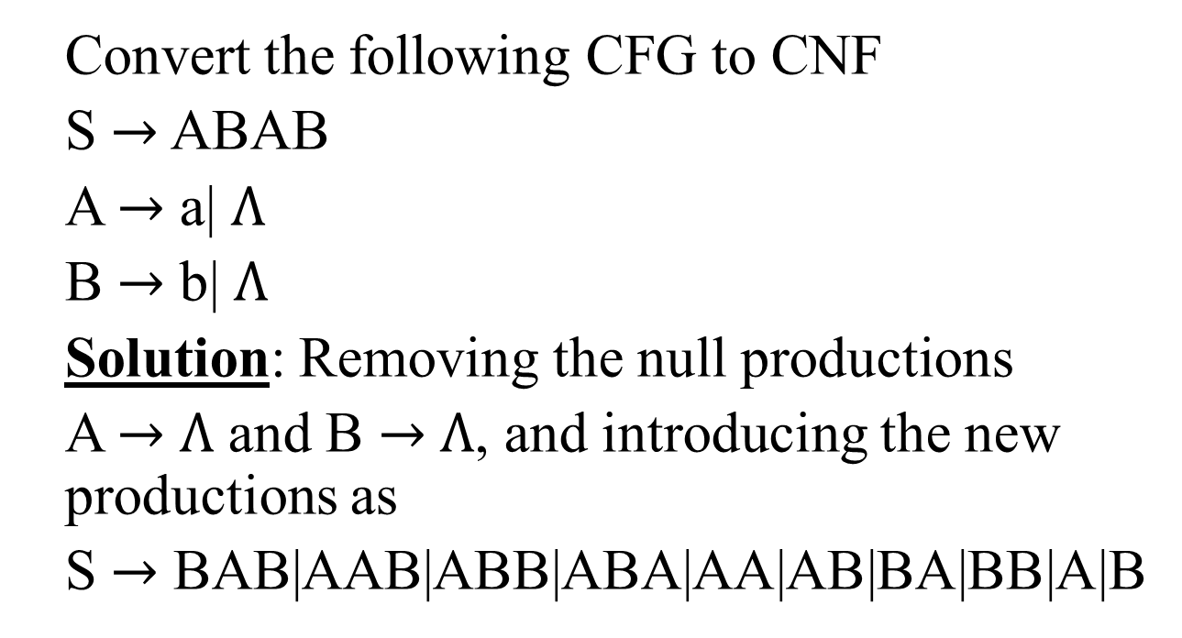
Solution of the Task
Convert the following CFG to CNF
S $→$ ABAB
A $→$ a| $Λ$
B $→$ b| $Λ$
Solution: Removing the null productions
A $→$ $Λ$ and B $→$ $Λ$, and introducing the new productions as
S $→$ BAB|AAB|ABB|ABA|AA|AB|BA|BB|A|B

Slide 3
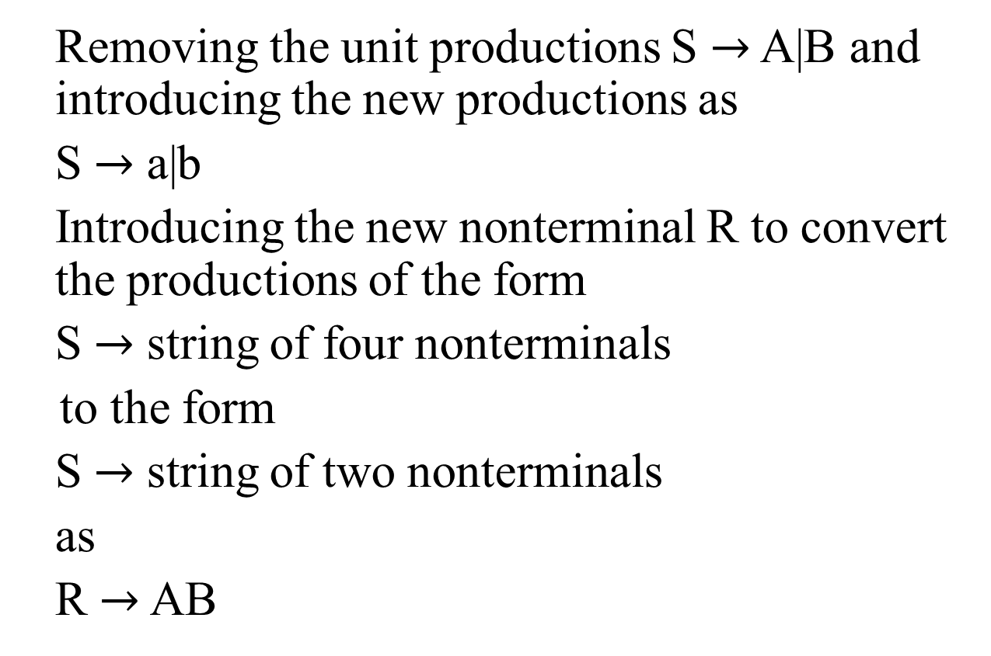
Solution contd …
Removing the unit productions S $→$ A|B and introducing the new productions as
S $→$ a|b
Introducing the new nonterminal R to convert the productions of the form
S $→$ string of four nonterminals
to the form
S $→$ string of two nonterminals
as
R $→$ AB

Slide 4
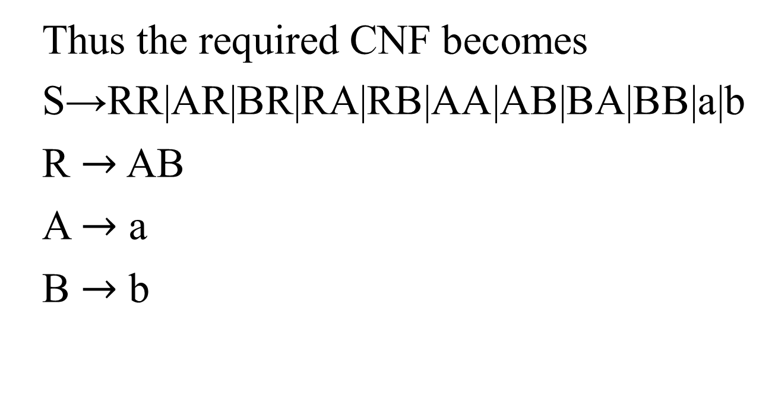
Solution continued …
Thus the required CNF becomes
S→RR|AR|BR|RA|RB|AA|AB|BA|BB|a|b
R $→$ AB
A $→$ a
B $→$ b

Slide 5
A new format for FAs
A class of machines (FAs) has been discussed accepting the regular language i.e. corresponding to a regular language there is a machine in this class, accepting that language and corresponding to a machine of this class there is a regular language accepted by this machine. It has also been discussed that there is a CFG corresponding to regular language and CFGs also define some nonregular languages, as well

Slide 6
A new format for FAs contd. …
There is a question whether there is a class of machines accepting the CFLs? The answer is yes. The new machines which are to be defined are more powerful and can be constructed with the help of FAs with new format.
To define the new format of an FA, the following are to be defined

Slide 7
A new format for FAs contd. …
Input TAPE
The part of an FA, where the input string is placed before it is run, is called the input TAPE.
The input TAPE is supposed to accommodate all possible strings. The input TAPE is partitioned with cells, so that each letter of the input string can be placed in each cell. The input string abbaa is shown in the following input TAPE.

Slide 8
Input TAPE contd…
The character ∆ indicates a blank in the TAPE. The input string is read from the TAPE starting from the cell (i).
It is assumed that when first ∆ is read, the rest of the TAPE is supposed to be blank.
Cell i
Cell ii
Cell iii
a
b
b
a
a
∆
∆
.

Slide 9
The START state
START: This state is like initial state of an FA and is represented by
START

Slide 10
An Accept state
ACCEPT: This state is like a final state of an FA and is expressed by
ACCEPT

Slide 11
A REJECT state
REJECT: This state is like dead-end non final state and is expressed by
NOTE: It may be noted that the ACCEPT and REJECT states are called the halt states.
REJECT

Slide 12
A READ state
READ: This state is to read an input letter and read to some other state. The READ state is expressed by
a
b
READ
∆

Slide 13
Example
Before some other states are defined consider the following example of an FA alongwith its new format
Obviously the above FA accepts the language of strings, expressed by (a+b)*a. Following is the new format of the above FA
b
a
a
x-
y+
b

Slide 14
Example contd. …
START
b
a
∆
READ
READ
b
a
∆
REJECT
ACCEPT

Slide 15
Note
The ∆ edge should not be confused with -labeled edge. The ∆-edges start only from READ boxes and lead to halt states.
Following is another example

Slide 16
Example
The above FA accepts the language expressed by (a+b)*bb(a+b)*
a
a,b
b
-
1
b
+
a

Slide 17
Example cont. …
START
a
a,b
a
READ
b
READ
b
READ
∆
∆
∆
REJECT
REJECT
ACCEPT

Slide 18
PUSHDOWN STACK or PUSHDOWN STORE
PUSHDOWN STACK: PUSHDOWN STACK is a place where the input letters can be placed until these letters are refered again. It can store as many letters as one can in a long column.
Initially the STACK is supposed to be empty i.e. each of its storage location contains a blank.
PUSH : A PUSH operator adds a new letter at the top of STACK, for e.g. if the letters a, b, c and d are pushed to the STACK that was initially blank, the STACK can be shown as

Slide 19
PUSH and STACK contd. …
STACK
The PUSH state is expressed by
d
c
b
PUSH a
a
When a letter is pushed, it replaces the existing letter and pushes it one position below.
∆
-

Slide 20
POP and STACK
POP: POP is an operation that takes out a letter from the top of the STACK. The rest of the letters are moved one location up. POP state is expressed as
b
a
POP
∆

Slide 21
Note
It may be noted that popping an empty STACK is like reading an empty TAPE, i.e. popping a blank character ∆.
It may also be noted that when the new format of an FA contains PUSH and POP states, it is called PUSHDOWN Automata or PDAs. It may be observed that if the PUSHDOWN STACK (the memory structure) is added to an FA then its language recognizing capabilities are increased considerably. Following is an example of PDA

Slide 22
Example: Consider the following PDA
START
a
∆
PUSH a
READ1
b
b
a
∆
POP2
POP1
READ2
∆
b,
∆
a,b
REJECT
ACCEPT
REJECT

Slide 23
Example contd. …
The string aaabbb is to be run on this machine. Before the string is processed, the string is supposed to be placed on the TAPE and the STACK is supposed to be empty as shown below
a
a
a
b
b
b
∆
∆
…

Slide 24
Example contd. …
Reading first a from the TAPE we move from READ1 State to PUSH a state, it causes the letter a deleted from the TAPE and
added to the top of the STACK,
as shown below
STACK
∆
-
-
-

Slide 25
Example contd. …
/
a
a
a
b
b
b
∆
∆
…
TAPE
STACK
a
∆
-
-

Slide 26
Example contd. …
Reading next two a’s successively, will delete further two a’s from the TAPE and add these letters to the top of the STACK, as shown below
STACK
a
/
a
a
/
/
a
a
b
b
b
∆
∆
…
TAPE
a
∆
…

Slide 27
Example contd. …
Then reading the next letter which is b from the TAPE will lead to the POP1 state. The top letter at the STACK is a, which is popped out and READ2 state is entered. Situation of TAPE and STACK is shown below
STACK
a
a
/
/
a
/
/
a
a
b
b
b
∆
∆
…
TAPE
∆
-
…

Slide 28
Example contd. …
Reading the next two b’s successively will delete two b’s from the TAPE, will lead to the POP1 state and these b’s will be removed from the STACK as shown below
STACK
∆
/
/
/
/
a
/
/
a
a
b
b
b
∆
∆
…
-
TAPE
-
-
…

Slide 29
Example contd. …
Now there is only blank character ∆ is left to be read from the TAPE, which leads to POP2 state. While the only blank characters is left in the STACK to be popped out and the ACCEPT state is entered, which shows that the string aaabbb is accepted by this PDA. It may be observed that the above PDA accepts the language {a^{n}b^{n}:n=0,1,2, … }.
Since the null string is like a blank character, so to determine how the null string is accepted, it can be placed in the TAPE as shown below

Slide 30
Example contd. …
Reading ∆ at state READ1 leads to POP2 state and POP2 state contains only ∆, hence it leads to ACCEPT state and the null string is accepted.
Note: The process of running the string aaabbb can also be expressed in the following table
∆
∆
∆
…
TAPE

Slide 31
Example contd. …
Reading ∆ at state READ1 leads to POP2 state and POP2 state contains only ∆, hence it leads to ACCEPT state and the null string is accepted.
∆
∆
∆
…
TAPE

Slide 32
Summing Up
New format for FAs, input TAPE, START, ACCEPT , REJECT, READ states Examples of New Format of FA, PUSH Down STACK , PUSH and POP, Example of PDA

